Slide 1

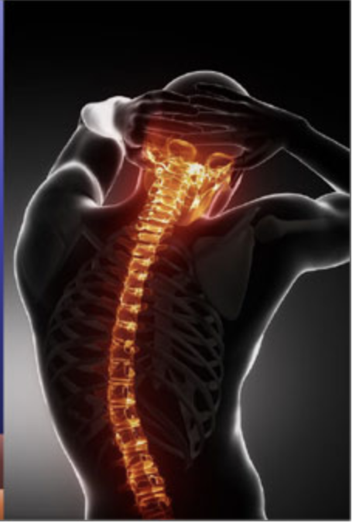
AI to Identify Spontaneous Intracranial Hypotension (SIH)
-- Medical Image Analysis
Milestone 2
Yuyang Zhu yz3691
Tianle Zhu tz2434

Slide 2
Outline
Project Recap
Implementation and progress of the project
Challenges and solutions
Exploration and discussion
Reference

Slide 3
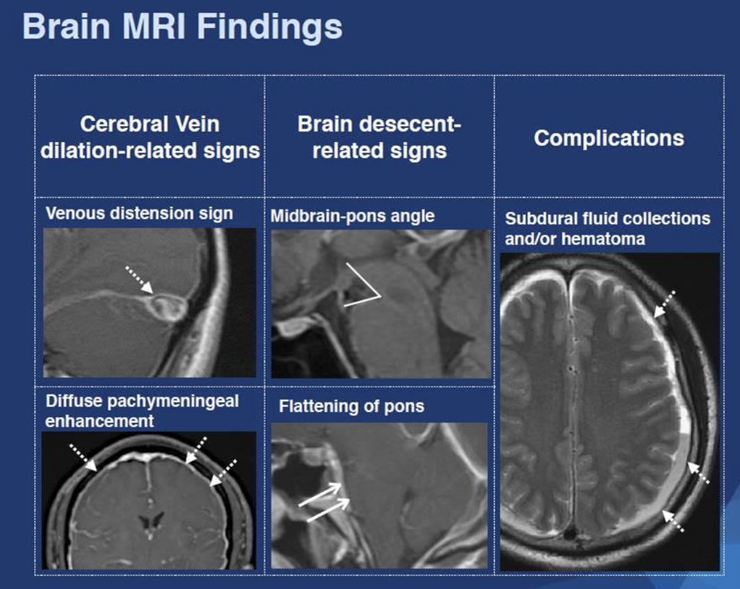
Project Recap
This project divided into two parts.
First, if the brain MRI is abnormal, it would conduct in ER often.
Cerebral Vein dilation-related signs: Venous distension; Diffuse pachymeningeal enhancement
Brain descent related signs: midbrain pons angle and flattening of pons
Complications: subdural fluid collections and/or subdural hematoma.

Slide 4
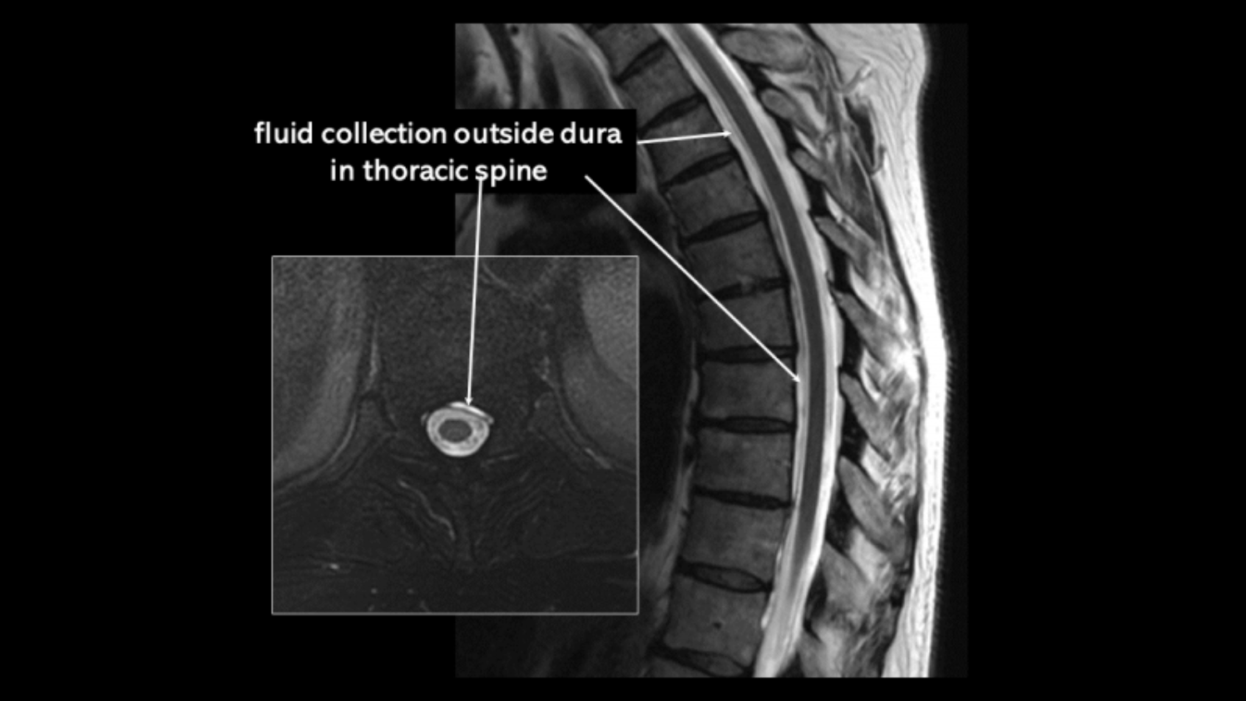
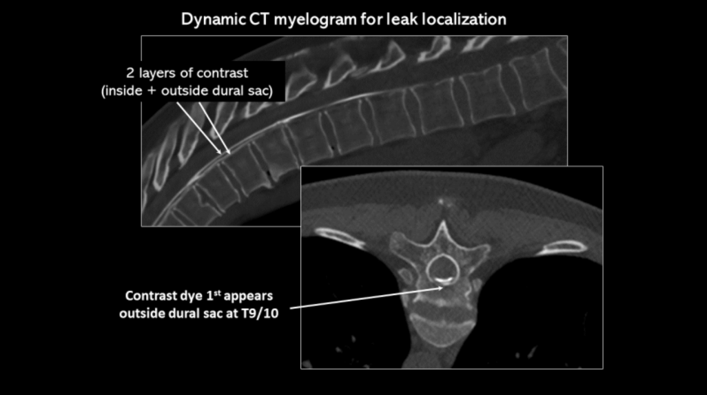
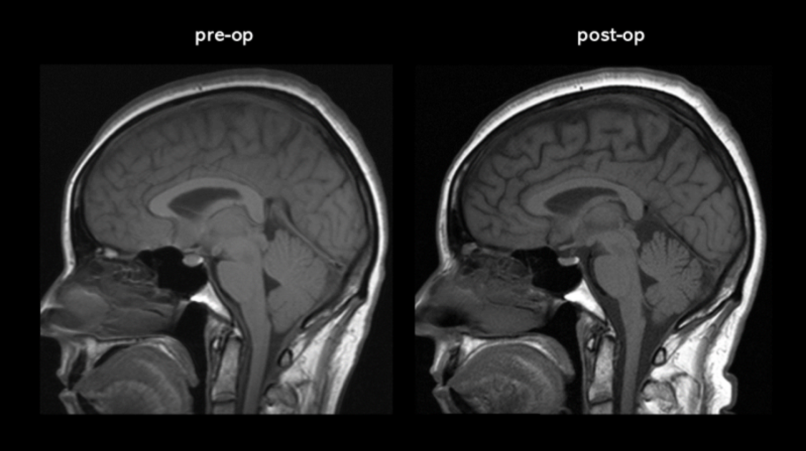
Project Recap
Secondly, the patient with abnormal MRI will do spine MRI further.
Our SIH dataset
Partial data (three patients): 417 Brain MRIs
584 Spinal MRIs
The pictures[1] from: https://spinalcsfleak.org/katies-story/

Slide 5
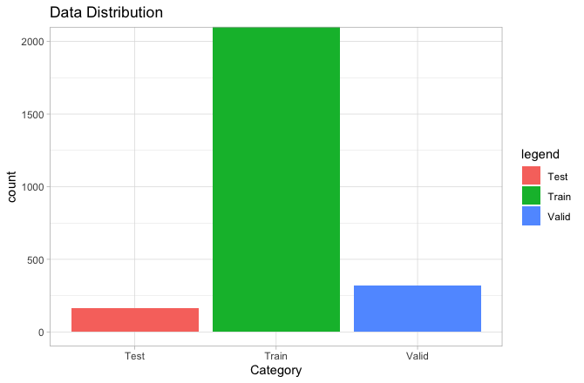
Implementation and Progress -- Brain MRI Segmentation[2]
Data Augmentation
Data Distribution:
Train: 3949x2
Validation: 318
Test: 162
Create one augmented image for each image in the training set:
Rotation up to 40 degrees.
Width and height shift up to 20%
A slight shearing
A slight zooming
Horizontal flip

Slide 6
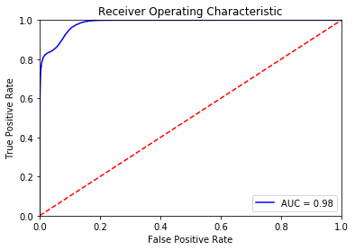
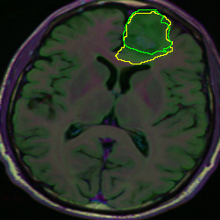
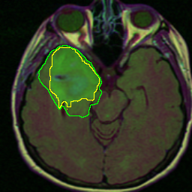
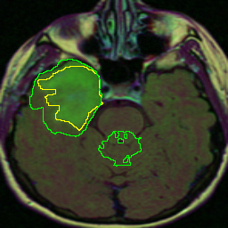
Implementation and Progress -- Brain MRI Segmentation
UNet[4]: Fit the model
Different loss functions:
Cross Entropy Works out
Intersection over Union
Dice coefficient
Some Outputs:
We choose 0.3 as a threshold to control false positive rates

Slide 7
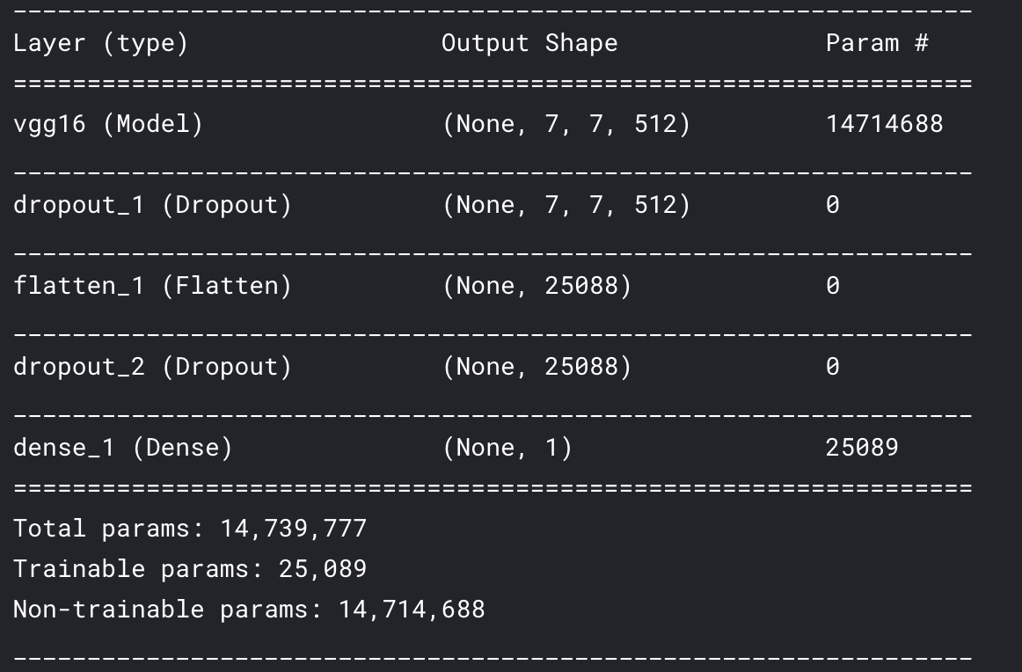
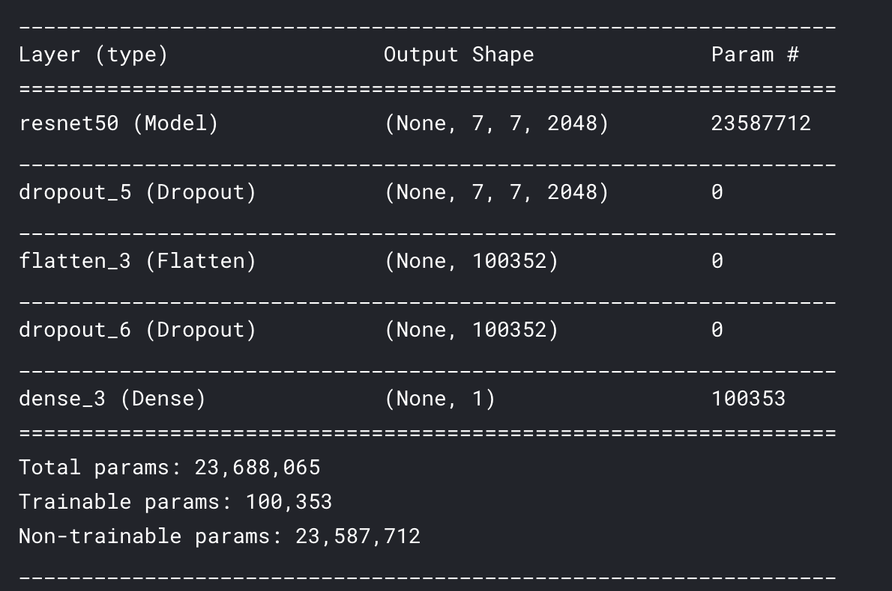
Implementation and Progress-- Brain Tumor MRI dataset[3]
Classification -- ResNet50[5] and VGG16[6]
Data preprocessing
Split the data:
Train: 193 images (224 *224*1)
Validation: 50 images (224 *224*1)
Test: 10 images (224 *224*1)
Cropped images
Changed size of images: 224*224
Transfer learning:
VGG16:
Earliest successes of Convolutional Neural Networks in image recognition tasks
Pre-trained weights were trained on ImageNet data
Use very small convolution filters to reduce parameter space
ResNet50:
50 layers deep
Classify images into 1000 object categories
Skip connection
Notes:
VGG16:
one of the earliest successes of Convolutional Neural Networks in image recognition tasks. It tried to increase network depth to improve model performance. The authors use very small convolution filters to reduce parameter space. The network generalizes extraordinary well to image recognition, classification and localization tasks. The VGG16 pre-trained weights were trained on ImageNet data
ResNet50:
A residual learning framework that can have substantially deeper neural network architecture than those used previously. The author explicitly reformulates the layers as learning residual functions by utilizing skip connections. Skip connections then become the standard computer vision modeling mechanism. The residual networks are easier to optimize and can gain accuracy from considerably increased depth. ResNet pre-trained models are trained on ImageNet data which has 1000 classes of objects.
是什么， layers
主要创新点： skip connection： 是什么：
数据集，用的什么data trained resnet 50
Before transfer learning
Original output and after transfer learning output
ResNet-50：a convolutional neural network that is trained on more than a million images from the ImageNet database [1]. The network is 50 layers deep and can classify images into 1000 object categories (keyboard, mouse, pencil, and many animals).
Parameters: 25.6 million.
The image input size is 224 by 244.
Main Innovative point: Skip connection

Slide 8
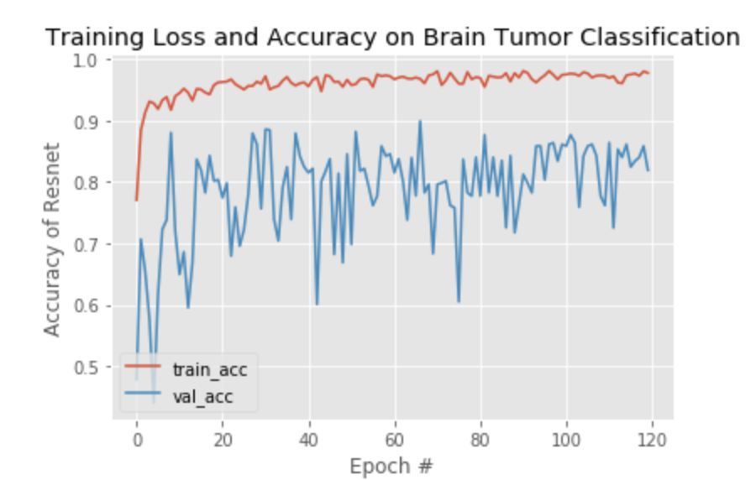
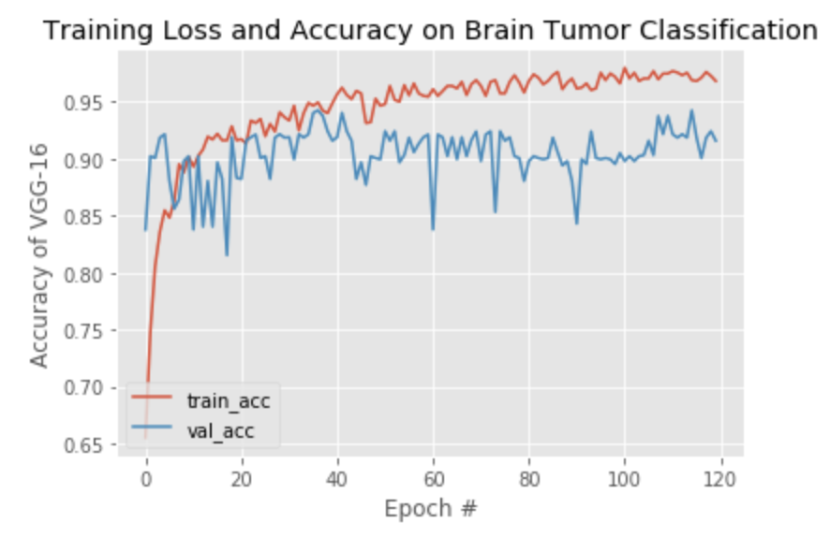
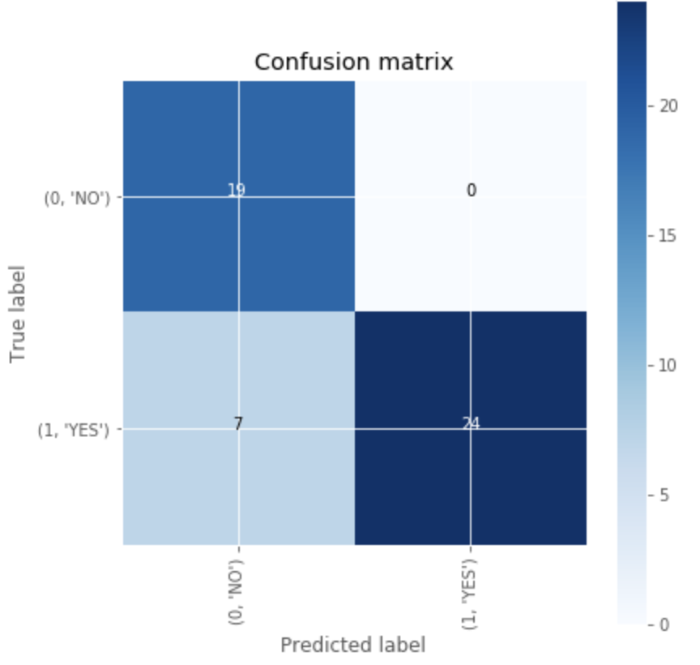
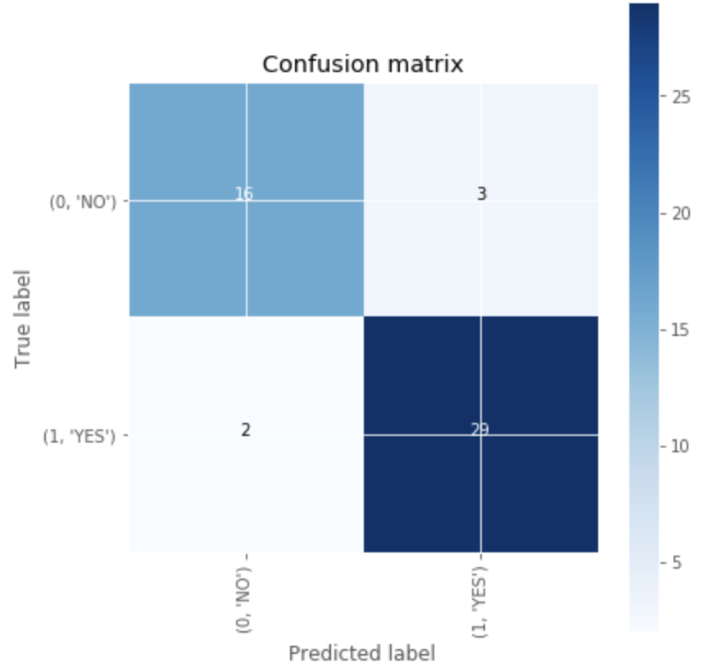
Implementation and Progress-- Brain Tumor MRI dataset
Classification -- ResNet50 VS VGG16
●Hyperparameter setting
○Echo = 120 (50 steps in each echo)
○Loss function = Binary Cross Entropy
○Optimizer = Adam
●Results
○Accuracy= # correctly predicted images
# total tested images
VGG16 = 90%
ResNet50 = 86%
ResNet50 VGG16

Slide 9
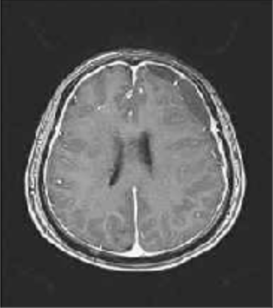
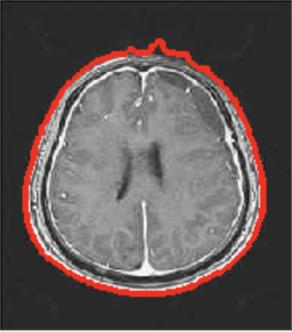
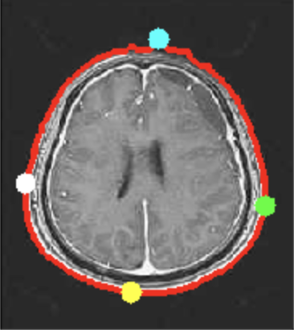
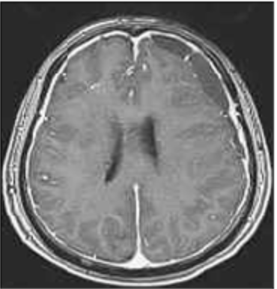
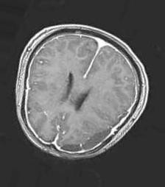
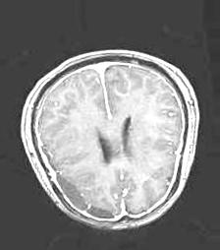
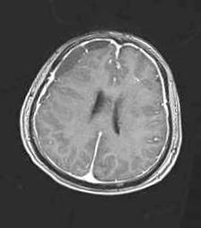
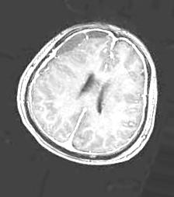
Implementation and Progress -- Our Dataset
Spinal and Brain MRI Data preprocessing：
Brain MRI：
Crop the original image
Step 1: get the original image Step 2: Find the biggest contour Step 3: Find the extreme points Step 4: Crop the image
Data augmentation:
Resize, rotated, shift, brightness...

Slide 10
Challenges and Solution
Challenges:
The data of interest in this project is different from the training data of models used in transfer learning. Therefore, fine-tuning is required to improve model performance.
The architecture of the original model is designed for ImageNet data which has 1000 classes. Therefore, we need to customize the classification layers and tune hyperparameters to find the best parameter space.

Slide 11
Challenges and Solution
Solution:
Unfreeze the weights initialized from ResNet50 and VGG16 with a small learning rate. The model would be able to slowly adjust the weight to detect new features which could perform better in classifying brain tumor.
Explored the hyperparameter space (number of dense layers and dropout layers, dropout rate, number of neurons ) of the classifier and select the hyperparameter set with the best validation performance in terms of accuracy.

Slide 12
Exploration and Discussion
Explore related datasets and find similarities and useful methods to detect features like midbrain pons-angle abnormality, flattening of the pons and venous distension.
Find different ways of data augmentation and preprocessing operations that make sense
Learn more about hyper parameters and loss functions to improve the model results.

Slide 13
Reference
https://spinalcsfleak.org/katies-story/
https://www.kaggle.com/mateuszbuda/lgg-mri-segmentation
https://www.kaggle.com/loaiabdalslam/brain-tumor-mri-classification-vgg16
O. Ronneberger, P. Fischer, and T. Brox. U-net: Convolutional networks for biomedical image segmentation. In International Conference on Medical image computing and computer-assisted intervention, pages 234–241. Springer, 2015.
K. He, X. Zhang, S. Ren, and J. Sun. Deep residual learning for image recognition.In Proceedings of the IEEE conference on computer vision and pattern recognition,pages 770–778, 2016.
K. Simonyan and A. Zisserman. Very deep convolutional networks for large-scale image recognition.arXiv preprint arXiv:1409.1556, 2014

Slide 14

Notes:
Milestone 1 will be evaluated based on these criteria:
1. Literature Survey / Past Related Work
2. Data Collection Difficulty
3. Novelty (e.g., Scientific / Business Value)
4. Technical Challenge
5. Milestone Planning
6. Presentation / Writing Clarity & Quality

